Slide 1
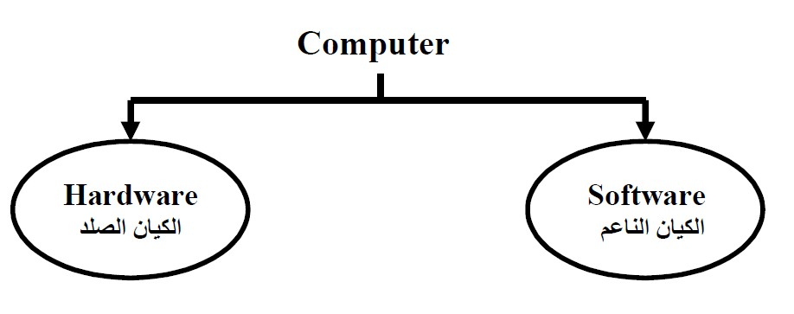
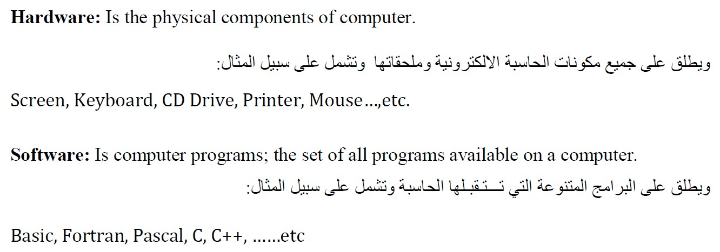
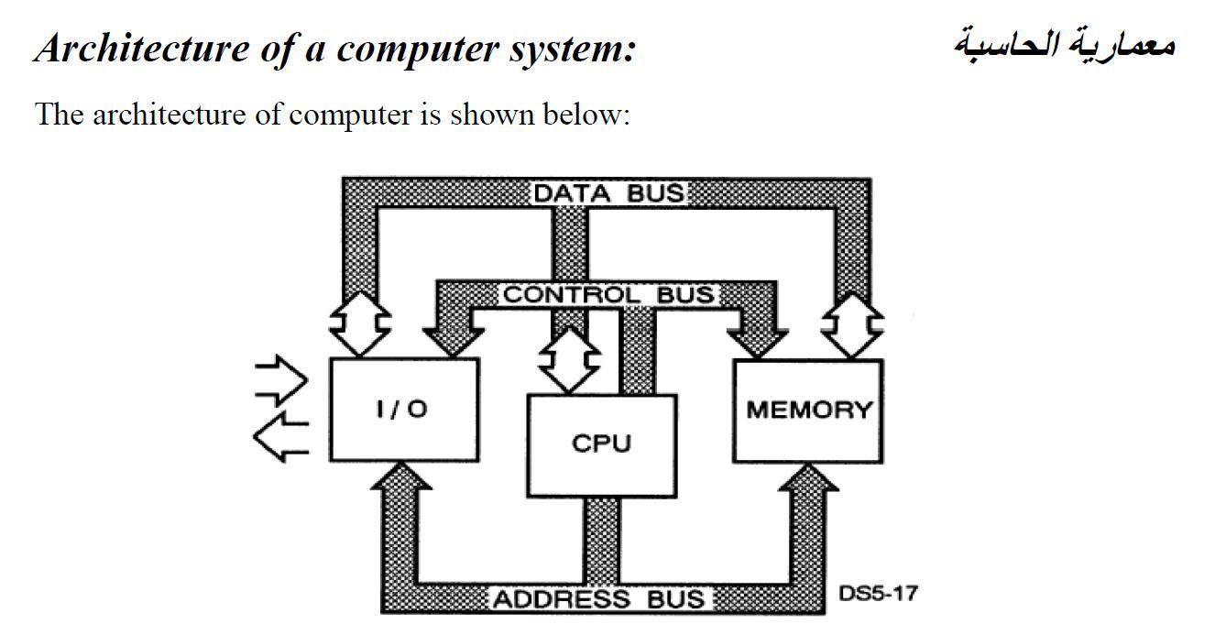
C++ lecture
Assistant lecture:Mayyadah S. Abrahim

Slide 2
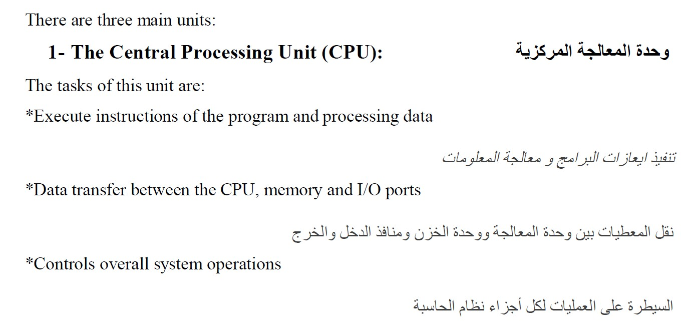
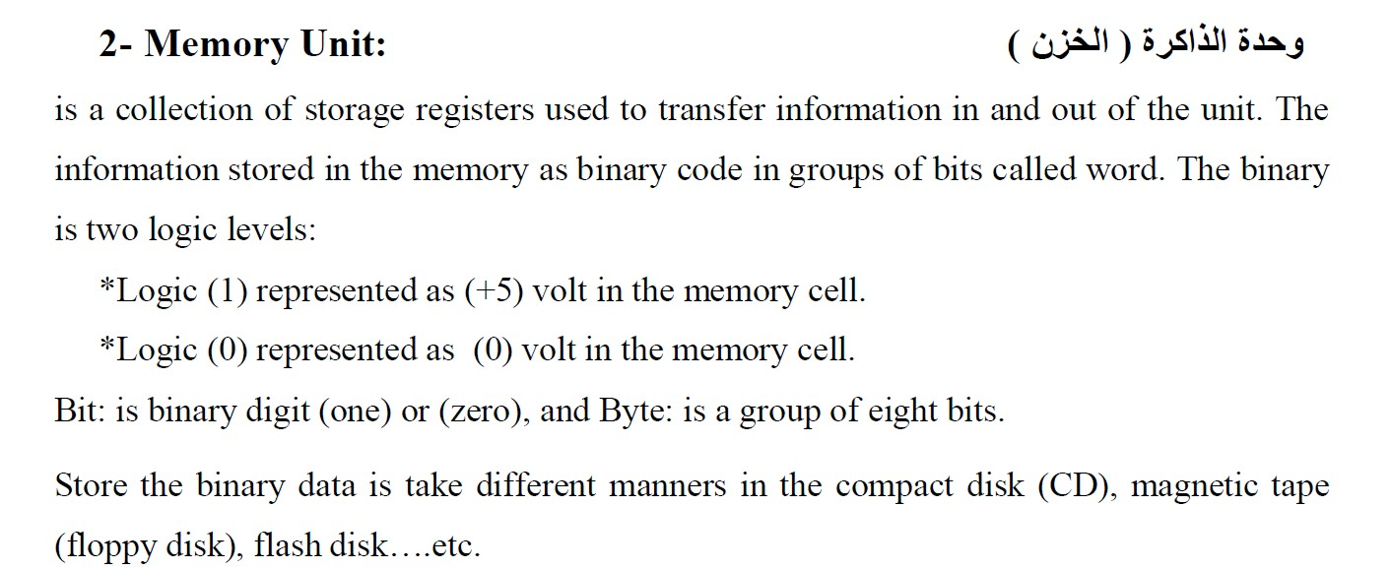
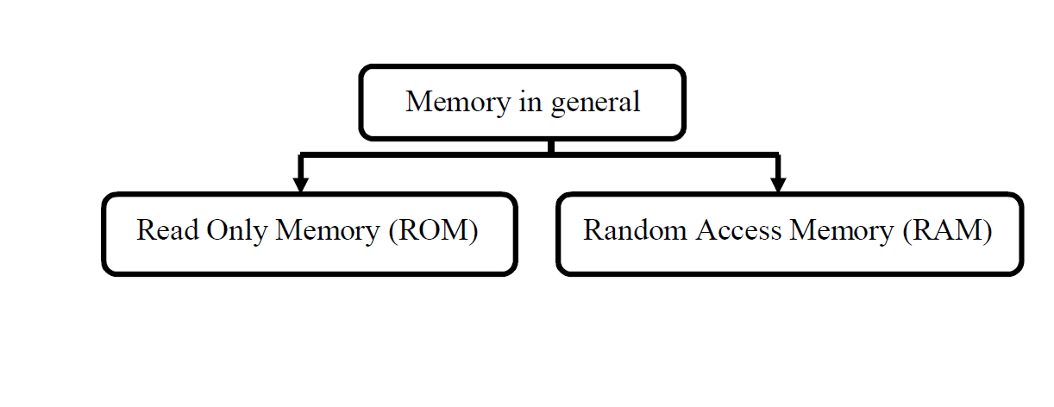
C++ lecture
Assistant lecture:Mayyadah S. Abrahim

Slide 3

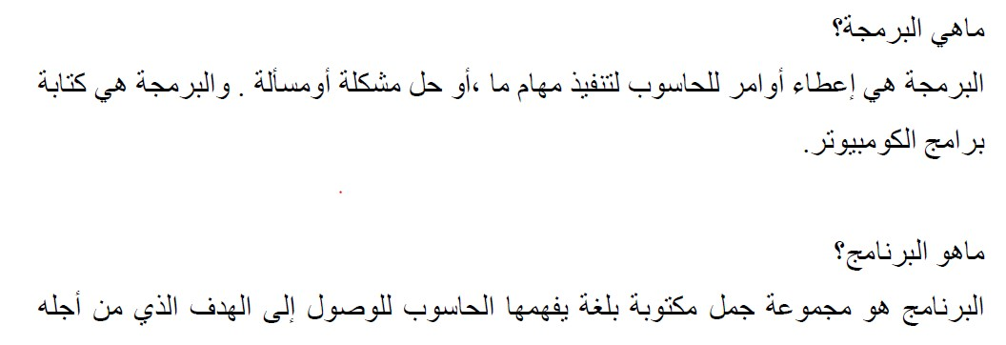

C++ lecture
Assistant lecture:Mayyadah S. Abrahim

Slide 4
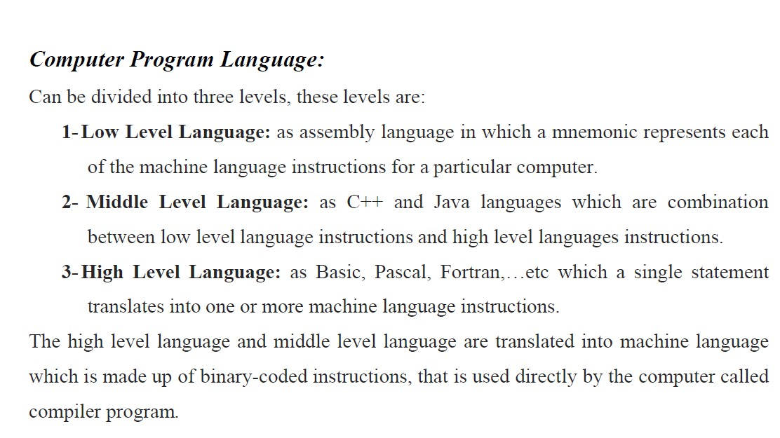

C++ lecture
Assistant lecture:Mayyadah S. Abrahim

Slide 5
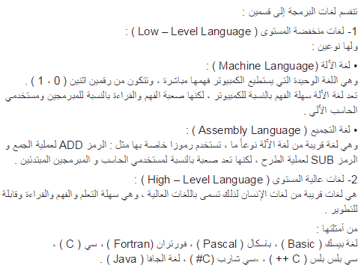


C++ lecture
Assistant lecture:Mayyadah S. Abrahim

Slide 6

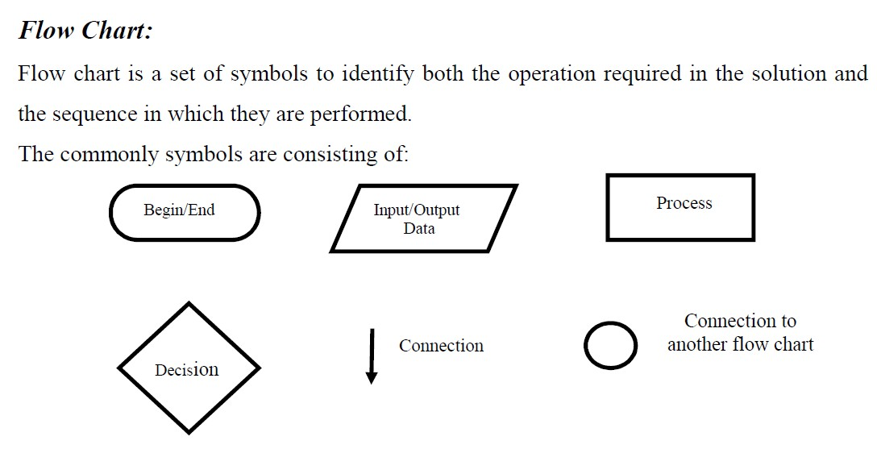
C++ lecture
Assistant lecture:Mayyadah S. Abrahim

Slide 7
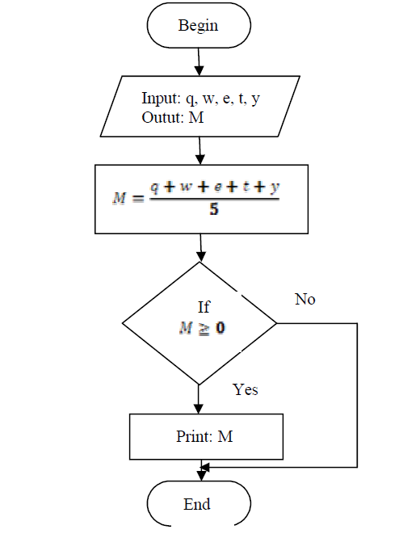
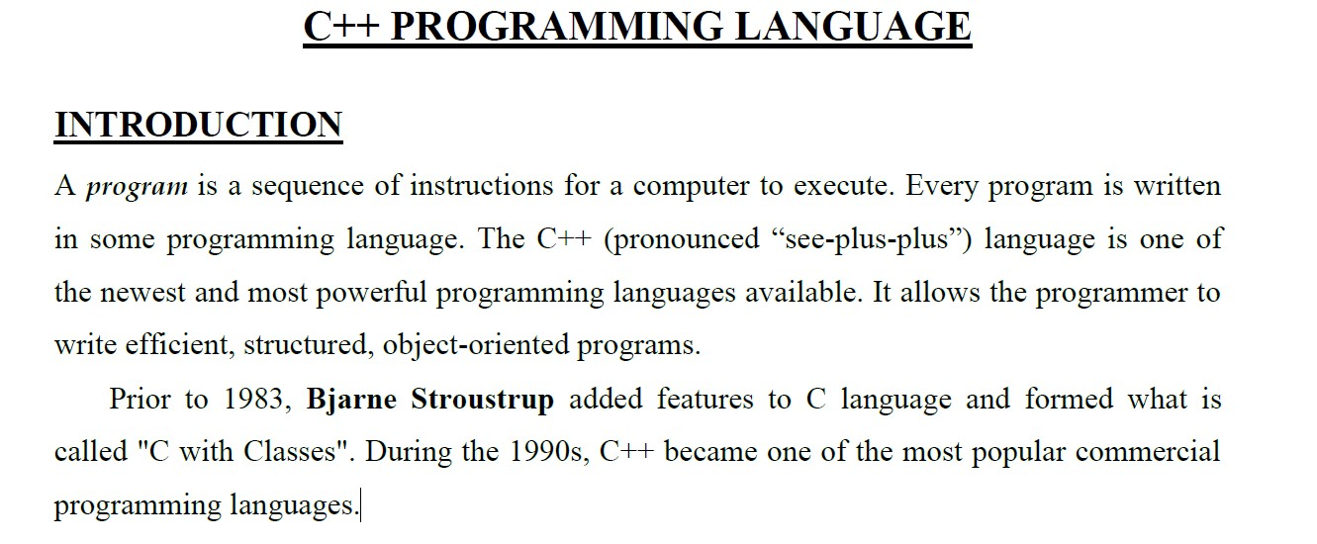
C++ lecture
Assistant lecture:Mayyadah S. Abrahim

Slide 8
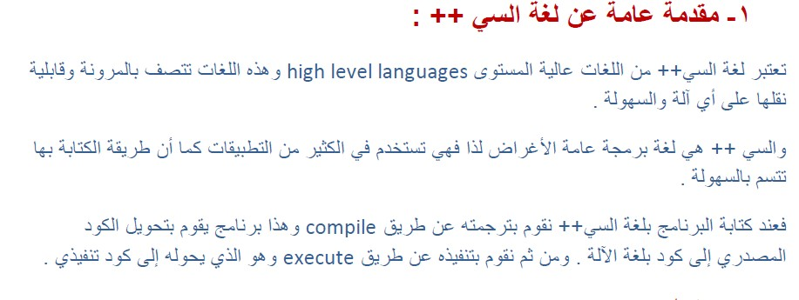


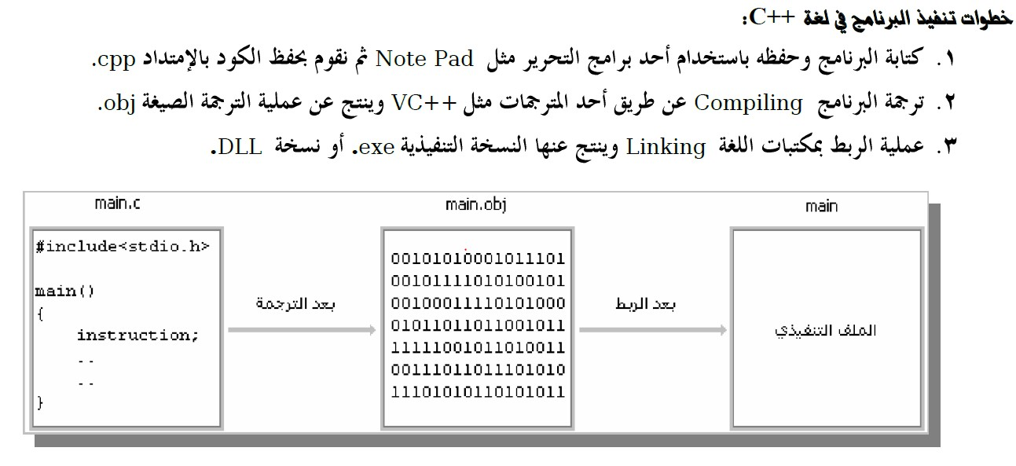
C++ lecture
Assistant lecture:Mayyadah S. Abrahim

Slide 9
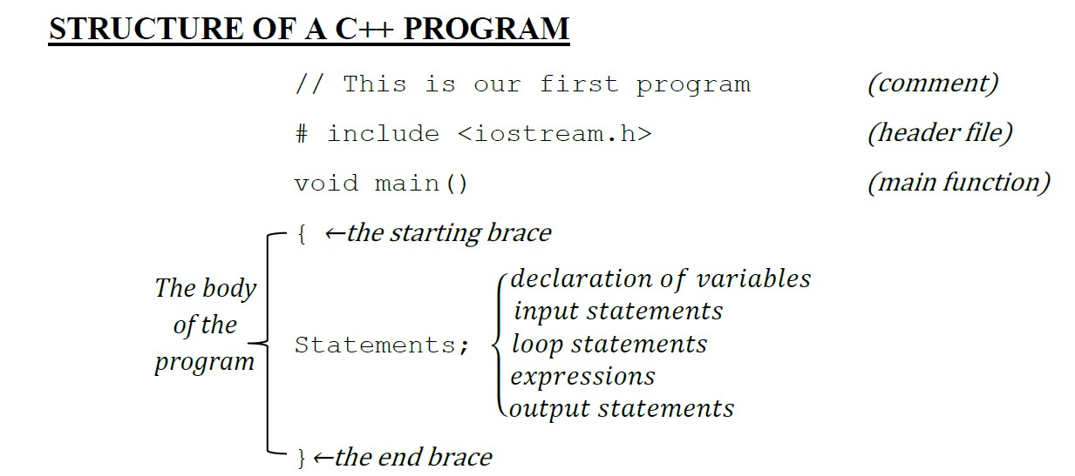
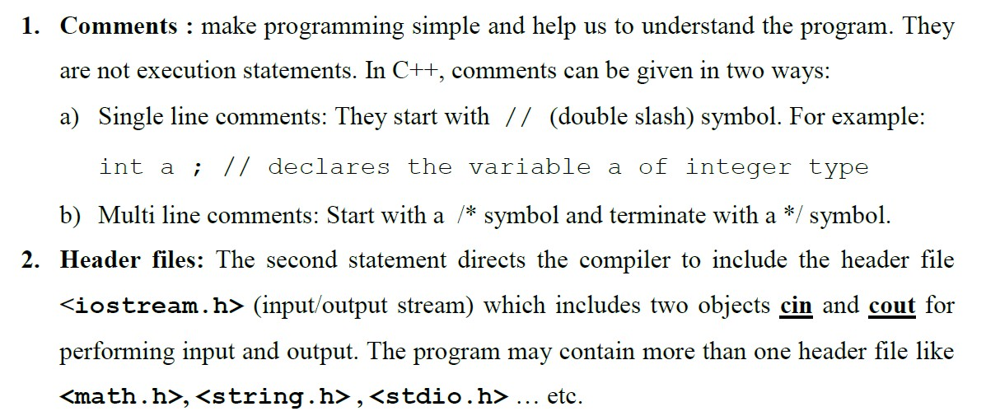

C++ lecture
Assistant lecture:Mayyadah S. Abrahim

Slide 10
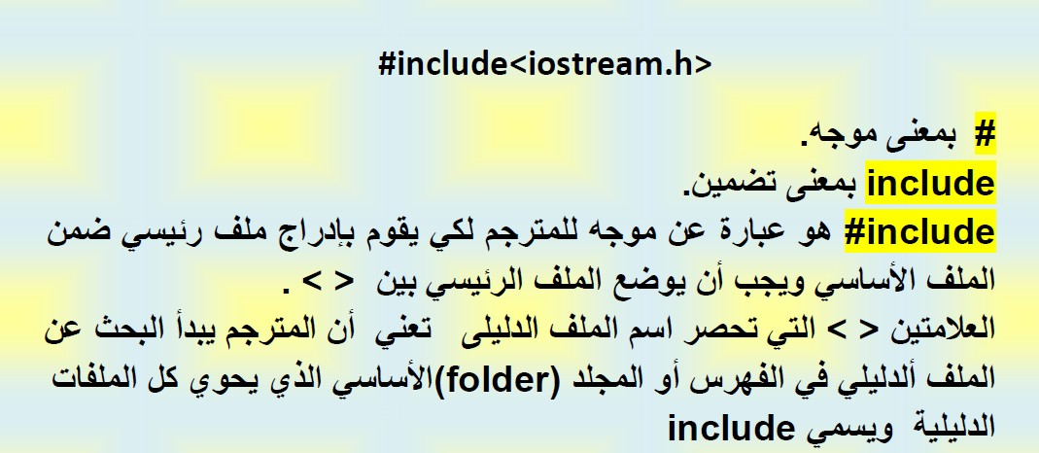
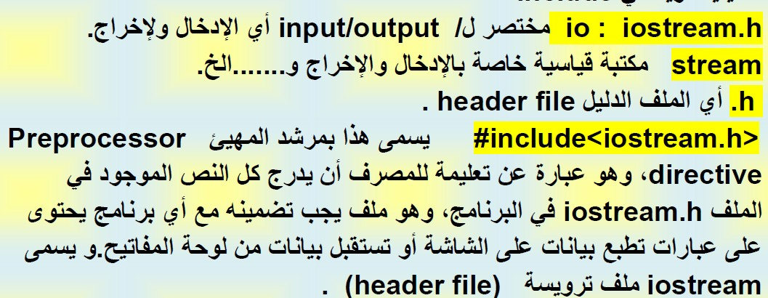
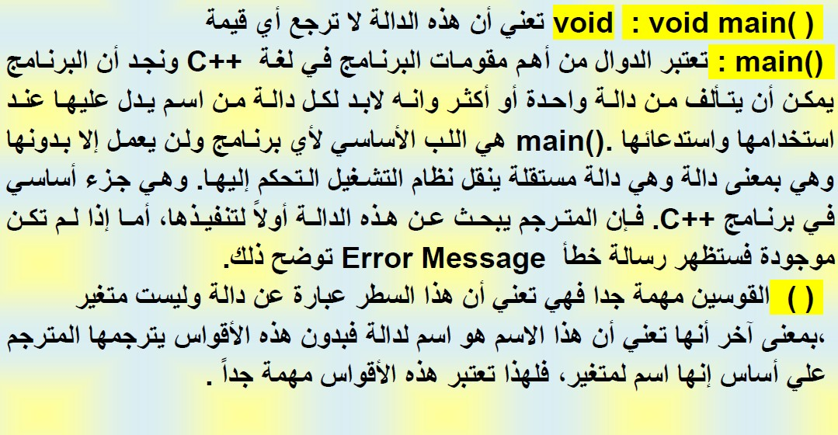
C++ lecture
Assistant lecture:Mayyadah S. Abrahim

Slide 11
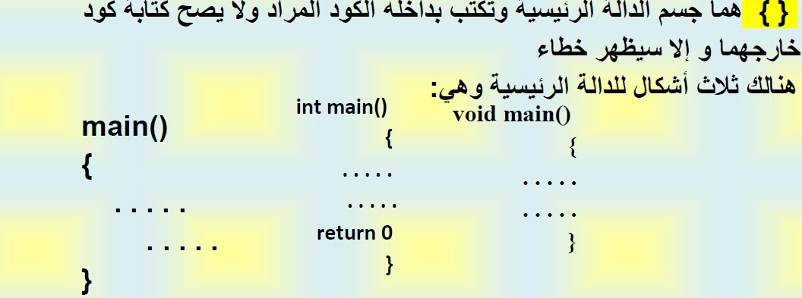
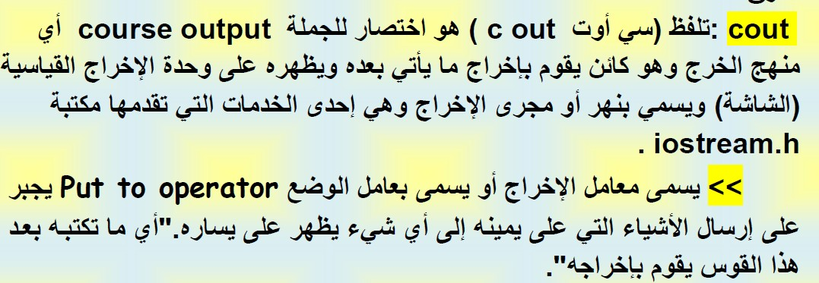


C++ lecture
Assistant lecture:Mayyadah S. Abrahim

Slide 12

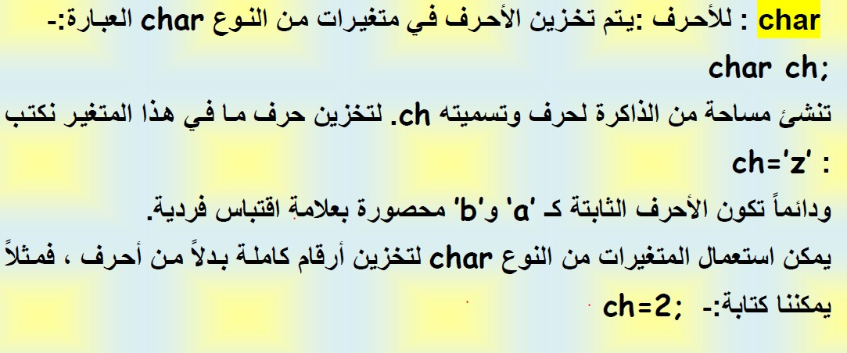

C++ lecture
Assistant lecture:Mayyadah S. Abrahim

Slide 13
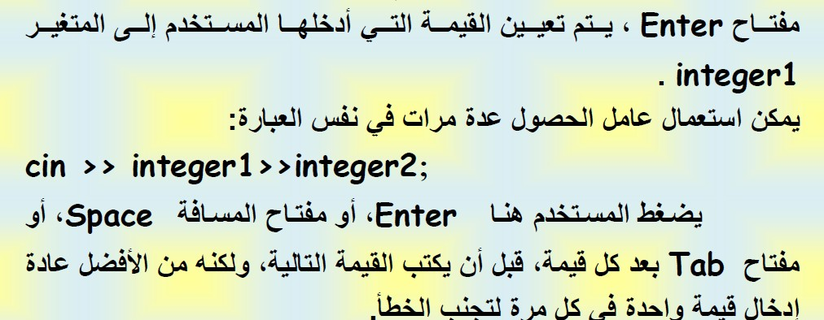
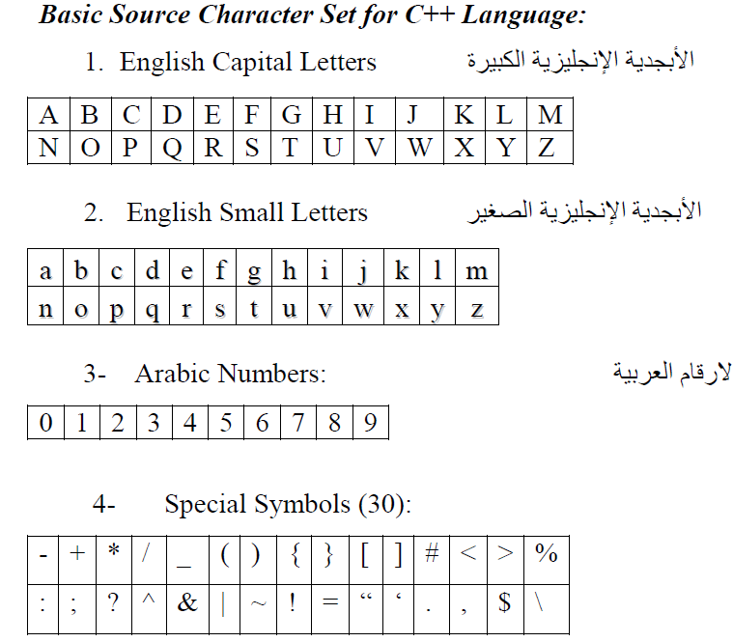
C++ lecture
Assistant lecture:Mayyadah S. Abrahim

Slide 14
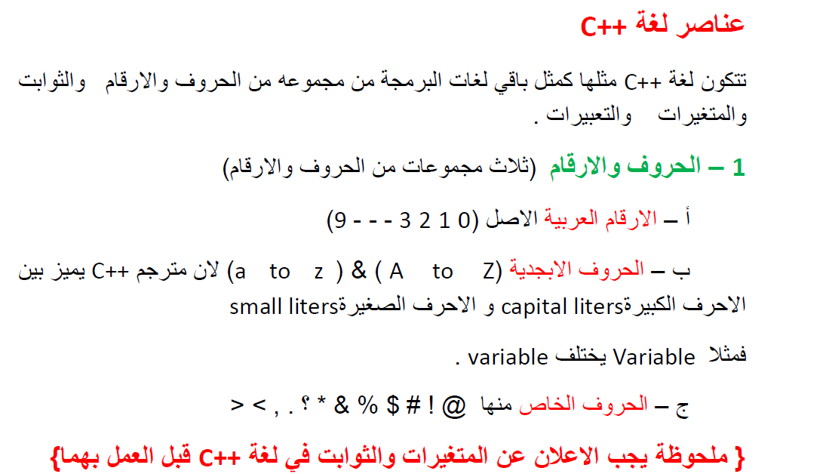

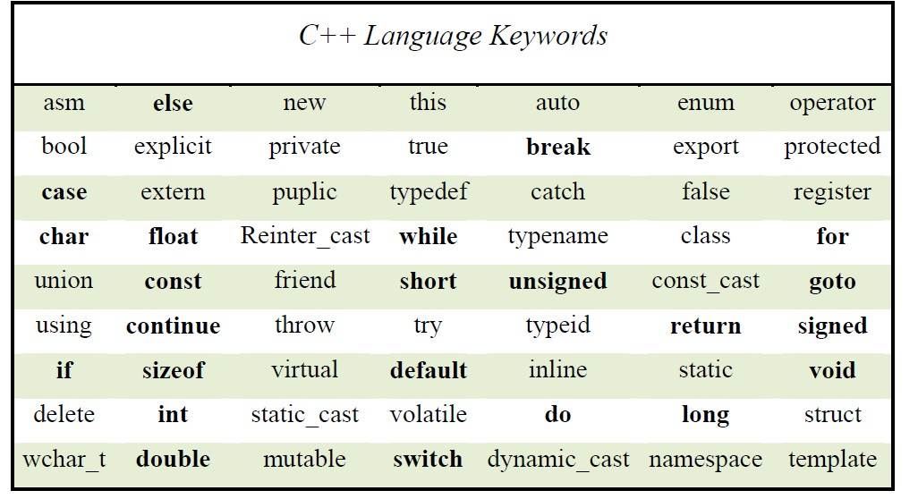
C++ lecture
Assistant lecture:Mayyadah S. Abrahim

Slide 15


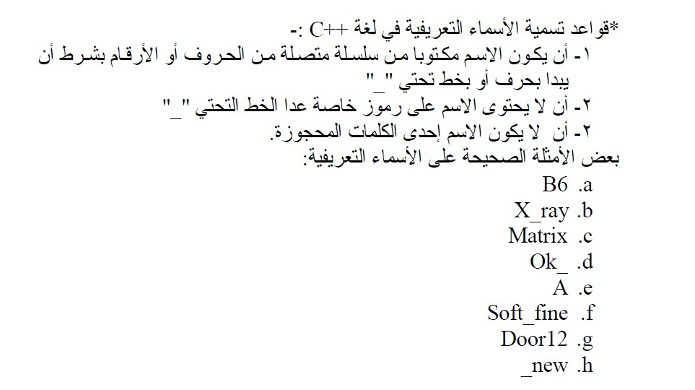
C++ lecture
Assistant lecture:Mayyadah S. Abrahim

Slide 16
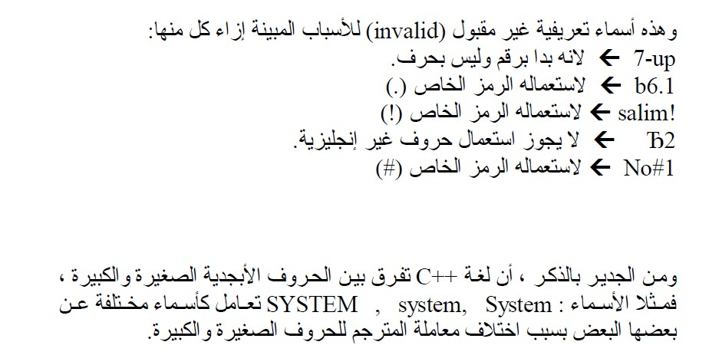

C++ lecture
Assistant lecture:Mayyadah S. Abrahim

